Slide 1
A One Stop Solution focusing on Tourism
7ISR- PIP2001 Capstone Project
Review-0
Batch Number: ISR-G01
ROLL NO STUDENT NAME
20211ISR0078 Bhavana B A
20211ISR0038 Disha R
20211ISR0021 Monika P
Under the Supervision of,
Dr. Alamelu Mangai Jothidurai
Associate Professor
School of Computer Science and Engineering
Presidency University
Name of the Program: B. Tech (Capstone Project)
Name of the HoD: Dr. Zafar Ali Khan
Name of the Program Project Coordinator: Dr. Mohammadi Akheela Khanum
Name of the School Project Coordinators: Dr. Sampath A K / Dr. Abdul Khadar A / Mr. Md Ziaur Rahman

Slide 2
Content
Problem Statement
Analysis of Problem Statement
Timeline of the Project
References

Slide 3
Problem Statement Number:
Organization: A one stop solution focusing on Tourism
Category : Software
Problem Description: In today's world people travel a lot to different cities and countries. But it is hard for them to travel in the city without prior knowledge. This is the prior motive behind making this app. A lot of websites and apps exist that do the similar job. An app exists that can book hotels, another for booking cabs, another for booking shows, events etc but what we want to do is to integrate all of this into one app in order to save time of the user. Similar apps do exist but they are not very efficient and are very time consuming. We aim to build an app that is user friendly and easy to use and will help people find out what they are looking for in a easier and time efficient way.
Difficulty Level: Simple

Slide 4
Analysis of Problem Statement
Technology Stack Components:
Identify Requirements
Frontend Technologies
Backend Technologies
Database Technologies
Additional Components
Integration and Compatibility

Slide 5
Analysis of Problem Statement (contd...)
Software and Hardware Requirements:
Software Requirements:
Frontend: HTML, CSS, and maybe JavaScript for interactive elements.
Backend: Python (Flask/Django) or Node.js
Database: MySQL or Firebase
UI Path: For process automation where needed.
Hardware Requirements:
Storage
Network Requirements
Peripheral Devices

Slide 6
Introduction and Features
Introduction: A tourist guide app that offers car booking, hotel booking, and place recommendations, tailored to user needs.
Problem Statement: Many tourists struggle to find all services (booking, recommendations) in one app, leading to inconvenience.
1. Car Booking Users can search, compare, and book rental cars. Filters by car type, price, and availability. Automated booking confirmation with UI Path.
2. Hotel Booking Simple search for hotels by price and location. Booking form with check-in/out and guest details. Automated booking process for confirmations.
3. Place Recommendations Personalized suggestions based on user preferences Categories like restaurants, attractions, and shopping Nearby attractions using GPS.
4. User-Friendly Interface Clean design with easy navigation. Interactive map for exploring places and getting info.

Slide 7
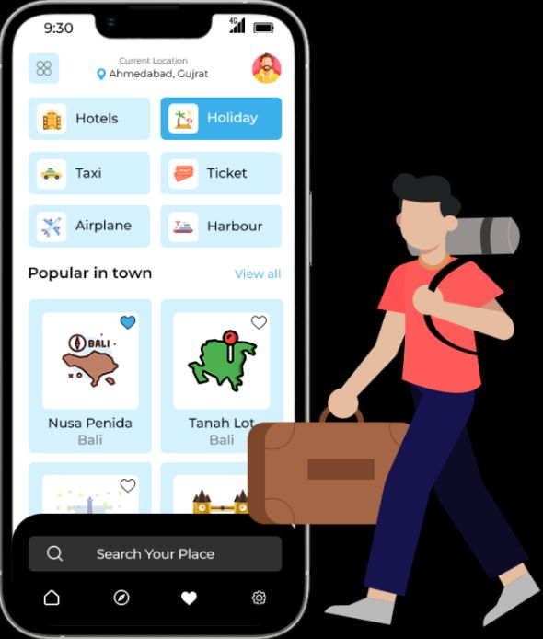
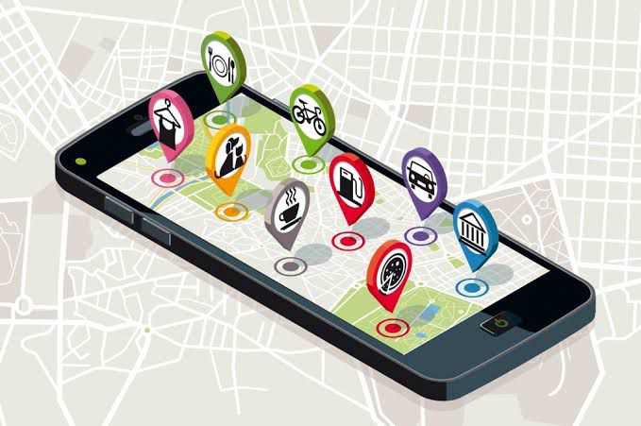

Slide 8
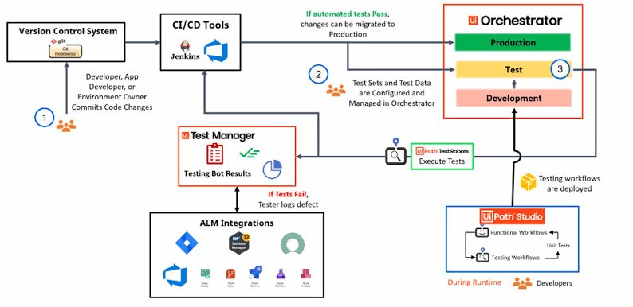

Slide 9
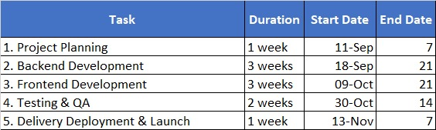
Timeline of the Project (Gantt Chart)
Task | Duration | Start Date | End Date
1. Basic UI design using HTML and CSS | Week 1-3 | 20-Sep | 10-Oct
2. Backend Development UI Path for car/hotel bookings) | Week 4-6 | 11-Oct | 31-Oct
3. Add personalized recommendations and location-based services | Week 7-8 | 01-Nov | 21
4. Testing and Bug fixing | Week 8-9 | 30-Oct | 14
5. Final adjustments and presentation | Week 10 | 13-Nov | 7

Slide 10
References (IEEE Paper format)
https://www.gousa.in/usa-experiences?no_geo_redirect=true&fy24_in_int_gen_getr_sem_pd_planning=&gad_source=1
https://www.linkedin.com/pulse/deep-dive-uipaths-technologies-application-tourism-sector-edvenswa-bvnfc?trk=organization_guest_main-feed-card_feed-article-content
https://medium.com/@polozdaria/travel-app-case-study-38e3e16b4db

Slide 11


